Slide 1

Amazon product recommendation system

Slide 2
Amazon product recommendation system
Group Members
Gowtham Paluri - 700741225
Ashok Sai Sudireddy– 700734963
Rithviksena Reddy Mallepally– 700737712

Slide 3
Amazon product recommendation system
Contribution in Project :
Gowtham: Designing project outline and milestones, Assigning tasks to each team member , Collecting data Removing null values and duplicates, Creating the project report in IEEE format.
Ashok sai : Constructing a weighted rating for the actual ratings and recommend the products based on weighted ratings, Review the code .
Rithviksena: Building user item recommendation system using SVD algorithm using sklearn library, Uploading the project on to Git as per guidelines .

Slide 4
Amazon product recommendation system
MOTIVATION :
Recommendation system estimates the user preferences based on the items purchased, users implicit rating and explicit rating. A good recommender system on an e-commerce site helps the users to find the best products according to their preferences automatically. In this project we are building a product recommendation system using Amazon electronics products dataset. To implement recommendation systems we have multiple techniques like memory based and model based. Model based approaches are easy to evaluate the results.

Slide 5
Amazon product recommendation system
Objectives :
  Content based filtering similarity between the products. Based on user history he searched the products he gets the recommendations using the similarity.But main challenges in this system are lack of novelty the system continuously recommends similar items. This method is not scalable because everytime a new product gets added to the products list it needs to be tagged. The other challenge is incorrect attributes information leads to incorrect recommendations. So we are opting for collaborative filtering in this paper. Memory based recommendation systems can not recommend the real-time recommendations and these systems are not fast and scalable. To overcome these challenges we are implementing a model based recommendation system.

Slide 6
Amazon product recommendation system
Related work :
In the study, recommendation systems (RS) have gained a lot of attention since they aim to help customers find products online by providing options that closely match their preferences. Customers might be recommended an irrelevant product if recommendations are made only based on quantitative reviews. Online retailers like Amazon and Flipkart utilise a variety of recommendation algorithms to present different options to various customers. Item-to-item collaborative filtering, used by Amazon, spreads to huge data sets and generates high-quality real-time suggestions. A user-friendly list of suggestions is created using the results of this type of filtering, which compares the items that customers have purchased and rated against related ones

Slide 7
Amazon product recommendation system
PROBLEM STATEMENT :
Recommendation system estimates the user preferences based on the items purchased, users implicit rating and explicit rating. A good recommender system on an e-commerce site helps the users to find the best products according to their preferences automatically. In this project we are building a product recommendation system using Amazon electronics products dataset.
Existing methods challenges:
● Content based filtering similarity between the products. Based on user history he searched the products he gets the recommendations using the similarity.But main challenges in this system are lack of novelty the system continuously recommends similar items. This method is not scalable because everytime a new product gets added to the products list it needs to be tagged. The other challenge is incorrect attributes information leads to incorrect recommendations. So we are opting for collaborative filtering in this paper.
● Memory based recommendation systems can not recommend the real-time recommendations and these systems are not fast and scalable. To overcome these challenges we are implementing a model based recommendation system.

Slide 8
Amazon product recommendation system
Proposed Solution :
To implement recommendation systems we have multiple techniques like memory based and model based. Model based approaches are easy to evaluate the results.
To recommend the products we have used two techniques:
● Popularity based recommendation—common recommendation
● User - Item collaborative filtering method—-personalized recommendation User- item collaborative filtering is implemented using the Matrix factorisation method ie. model based collaborative filtering SVD(Singular Value Decomposition) method. Experimental analysis is conducted on Amazon electronics products.The original source of the data is Recommender Systems and Personalization Datasets repository. The dataset contains 7 Million data points but due to memory constraints we have conducted the experiments on the subset of the data i.e. 5000 data points.

Slide 9
Amazon product recommendation system
Results :
A. Exploratory Data Analysis Exploratory data analysis is a mandatory step in machine learning pipeline. To understand the underlying structure of the data.Here we have summarize the data patterns using different visualizations barplots, density plots and count plots.
Since this is a model based approach so in the training phase we have applied the cross validation that is 5 fold cross validation and recorded the RMSE and MAE scores of the model for each fold.
Predictions In this project we have implemented the SVD using the suprise module we have trained the model using training set and predicted the potential products from the model

Slide 10
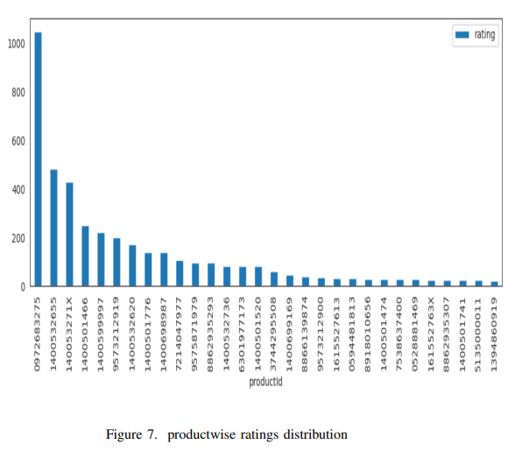
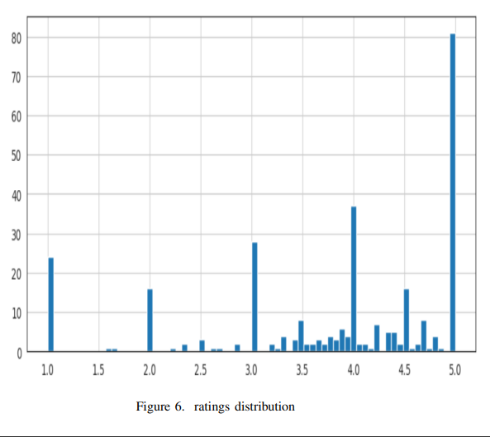
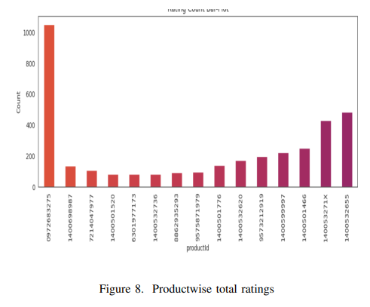
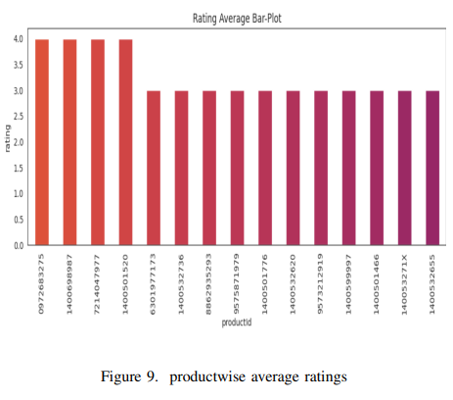

Slide 11
Amazon product recommendation system
References :
[1] Nur Syadhila Bt Che Lah, Ab Razak Bin Che Hussin, and Halina Mohamed Dahlan. A concept-level approach in analyzing review readership for e-commerce persuasive recommendation. In 2017 International Conference on Research and Innovation in Information Systems (ICRIIS), pages 1–5, 2017.
[2] Rahul Kumar Chaurasiya and Utkarsh Sahu. Improving performance of product recommendations using user reviews. In 2018 3rd International Conference and Workshops on Recent Advances and Innovations in Engineering (ICRAIE), pages 1–4, 2018.
[3] Lin Chen, Rui Li, Yige Liu, Ruixuan Zhang, and Diane Myung-kyung Woodbridge. Machine learning-based product recommendation using apache spark. In 2017 IEEE SmartWorld, Ubiquitous Intelligence Computing, Advanced Trusted Computed, Scalable Computing Communications, Cloud Big Data Computing, Internet of People and Smart City Innovation (SmartWorld/SCALCOM/UIC/ATC/CBDCom/IOP/SCI), pages 1–6, 2017.
[4] Utpal Chandra De, Shobhan Banerjee, Manas Kumar Rath, Tanmaya Swain, and Tapaswini Samant. Content based apparel recommendation for e-commerce stores. In 2022 3rd International Conference for Emerging Technology (INCET), pages 1–6, 2022.
[5] Negin Entezari, Evangelos E. Papalexakis, Haixun Wang, Sharath Rao, and Shishir Kumar Prasad. Tensor-based complementary product recommendation. In 2021 IEEE International Conference on Big Data (Big Data), pages 409–415, 2021

